Slide 1
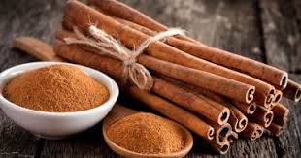
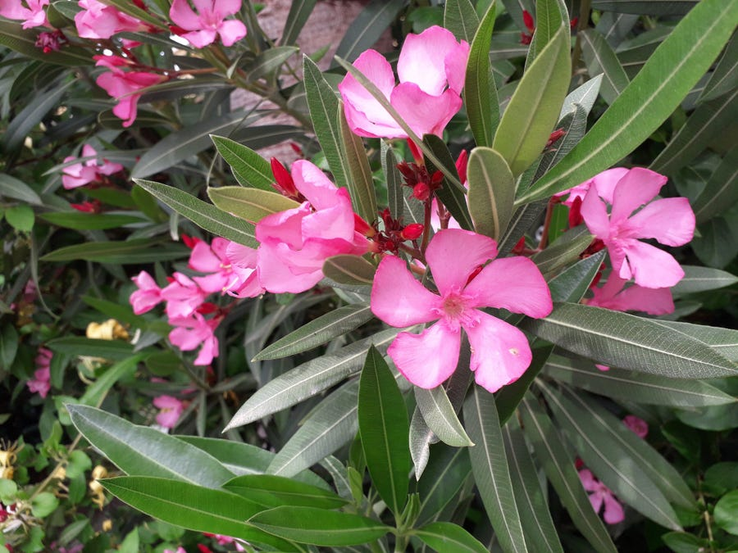
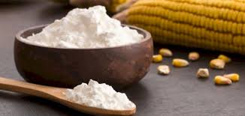
Microscopically identification for starch + calcium oxalate
Lab.1 Pharmacognosy second stage

Slide 2
Introduction
Pharmacognosy : is the study of starting material and substance intended for therapeutics, and biological origin, in other words obtained from plants , animals or by fermentation from microorganism.
There are several methods used to identify the drugs :
1-Organoleptic or macroscopical method (by the use the organ of sense ) includes :
Shape and size .
Color.
Odour .
Taste .
2-Microscopical method :
We use this method by examination of histological feature because crude drug has his element which vary from one crude drug to another.

Slide 3
Preparation of drugs for microscopical examination and general use of reagents
The following aims should be kept in mind for the microscopical examination of advanced crude drugs:
1- The determination of the size, shape and relative positions of the different cell and tissues.
2- The determination of chemical nature of the cell walls.
3- The determination of the form and chemical nature of cell content.
Disintegration serves for the isolation of the specific tissues and bleaching and defatting techniques for observing deeply colored materials and fatty seeds respectively. Almost certainly, clearing reagents will be required together with the range of suitable stains for cell wall and cell contents.

Slide 4
*Starch
Use of starch in pharmaceutical industry:
1- Dusting powder (in which adsorbent properties are important).
2- Antidote in treatment of iodine poisoning.
3- Skin moisturizing , basis for enemas.
4- Lubricant for surgeons gloves (sterilizable maize starch).
Macroscopical character:
Starch occurs in irregular, angular masses or as a white powder. It is insoluble in cold water but forms a colloidal solution on boiling with about 15 times it weight of water, the solution forming a translucent jelly on cooling. A starch mucilage is colored deep blue with solution of iodine, the color disappear on heating but reappear on cooling, when starch is heated with water the granules first swells and then undergo gelatinization, maize starch is neutral but other commercial starches show an acid ( wheat and potato) or alkaline (rice) reaction.

Slide 5
Microscopical examination of the starch
It should be mix with water. the size, shape and structure of starch granules from any particular plant varies within definite limits, so that it is possible to distinguish between the starch derived from different species.
Source of starch
1- Maize: Origin: obtained from the grains of the fruit of Zea mays , family: Poaceae
2- Potato: Origin: obtained from the tubers of Solanum tuberosum , family: Solanaceae

Slide 6
Procedure
1- Prepare starch solution: 1gm of starch in 100 ml D.W .
2- Examination of starch under microscope ; for this purpose take 1 drop from this solution (starch + D.W ) put it on slide then cover it with cover slide, then exam under microscope.
3- Also: we can detect any plant part contain starch by adding iodine solution directly on the plant part such as potato (positive result give bluish black color).
4- Also we can use starch with iodine test then exam under microscope.

Slide 7
*Calcium Oxalate
Calcium oxalate are found in plants as a result of interaction of oxalic acid (a metabolic product) with calcium salt; e.g. Ca-sulphate and the consequent precipitation upon super saturation of the cell sap with this salt. Different types of calcium oxalate crystals with various shapes can be used as a diagnostic element for plant identification. Calcium oxalate can crystalize into three forms: Monohydrate, Dihydrate , Trihydrate , only the monohydrate form is thermodinamically stable. Thus, in renal stones, only monohydrate and dehydrate forms were found. To obtain the trihydrate form low temperatures are required.

Slide 8
Character of Ca. oxalate
Solubility: insoluble in water.
Chemical formula of Ca. oxalate: CaC2O4 .
In this laboratory we use the following plant as source of ca.oxalate :
1- Cinnamon : Origin: obtained from the bark of Cinnamomum cassia , family: Lauraceae.
2- Oleander : Origin: obtained from the leaf of Nerium oleander , family: Apocynaceae .

Slide 9
Procedure (cinnamon)
1- Prepare cinnamon solution: 1gm of powder cinnamon in 100 ml D.W .
2- Examination various types of calcium oxalate crystals of cinnamon under microscope by taking 1 drop from this solution put it on slide then cover it with cover slide.

Slide 10
Procedure (oleander)
1- The leaves of the plant (oleander) were taken, then washed and cut into small bits. A transverse section of the leaf was treated with sodium hypochloride for bleaching,
2- Examined under a microscope to detect the presence of calcium oxalate crystals , which are found around the major vein and mesophyll tissue .

Slide 11
Thank you
Ola Alsaad

